Slide 1
Chapter 5
What is an Operating System?

Slide 2
Overview
What is an OS?
What devices have OSs?
Multitasking
Booting
Windows, Linux, OS X (now MacOS)

Slide 3
Lots To Choose From
Windows
OS X
Linux
Android
IOS
Chrome
And lots of versions of each

Slide 4
Evolution
Early computers ran one program
The program itself had to control all of the hardware all of the time
Know how much memory, disk, I/O, etc.
There is a lot of commonality between programs
Create “libraries” to do I/O, scheduling, etc.
Libraries were on cards and tapes

Slide 5
Batch
Programmers submitted cards and received printouts
Similar jobs (e.g.: all FORTRAN jobs) were batched together as they all used the same libraries
Running a number in a row was faster as library could be resident in memory

Slide 6
Evolution
Monitors
Single-user OSs
MS-DOS
Multi-user OSs
MULTICS, OS360, VM/CMS, VMS, etc.
“Big iron”
Functionality migrated down to PCs

Slide 7
Common OS Tasks
Details of input and output.
Mechanisms to check user names and passwords to identify authorized users.
Administration of a system to allow multiple users to work concurrently.
Allocation (and de-allocation) of main memory for different users.

Slide 8
Common OS Tasks
Sharing of resources (e.g., files, printers) among several users or machines.
Communication among users and machines.
Connections to the Internet or a local area network.
Mechanisms for protection and security of programs and information.

Slide 9
OS Tasks
Support users and their applications
Hide the hardware details
Sometimes a fine line between OS and app
Which is Internet Explorer?
Which is Windows Explorer?
Is Outlook Express and IE inseparable parts of OS?

Slide 10
OS Tasks
Sharing HW resources
Mouse: I/O to application
Printer: queuing
Disks: multiple open files and protection
Memory: how much does each app get
Networking
Word processing?
How sophisticated?

Slide 11
What Has an OS?
Microwave: no (but IoT)
Only one program running, controls all hardware
iPods, engine controls, etc.: maybe not
Does it run more than one task at a time?
Does it coordinate with other computers?
Cells phones, iPads (tablets): yes
Doing more than one thing at a time
Support other applications than those built in

Slide 12
What Has an OS?
Modern cars have dozens of computers that communicate via a common bus
Different kinds of OSs
Hard real time – for physical devices (engines, defibrillators, etc.)
No spinning disks, few concurrent tasks
Non real time
Most of the familiar
Task specific (tuned)

Slide 13
Emphases
Science (fast)
UNIX/Linux
Terse and powerful commands
Business (friendly)
Windows
GUIs
Artists
OS X, graphics

Slide 14
Convergence
Most OSs have similar interfaces and functionality these days
IOS and OS X derives from same code base
Android derived from Linux

Slide 15
Multitasking
Most users do many things at once
Even if they’re not aware of it
Only one CPU
Though often multiple cores these days
One CPU used to mean one task

Slide 16
Multitasking
CPU/cores often bored
Rapidly switch between various tasks
Appears computer is doing multiple tasks at once
Really isn’t, but switching between tasks fast enough to appear so
A task might contain multiple threads
Threads are independent functionality in a tasks
Tasks most often called “processes”

Slide 17
Multitasking
While waiting for I/O, work on another task
Share between tasks via round robin
Priority scheduling

Slide 18
Book Examples
Word processing and e-mail notification
Playing music and budgeting
Talking to another person over the Internet and finding a current weather forecast
Writing a wedding announcement and determining travel directions for the attendees
Showing a DVD and printer notification

Slide 19
Process Coordination
OSs coordinate between processes
Inter-Process Communication
Word processor needs to talk to print queue
Each print job needs exclusive use of the printer

Slide 20
Process Coordination
In general, a task will require exclusive use of some resources
The order those resources are used is also very important
OS takes care of resource reservation and use

Slide 21
Have You Tried Rebooting?
Returning OS to pristine state
Certain operations on the OS itself cannot be done while it’s running
Installing A/V, certain drivers, upgrading the OS itself
Sometimes we see what is happening during boot

Slide 22
Have You Tried Rebooting?
The OS keeps track of a lot of data
What portions of memory are in use
What disk, CD, I/O devices are connected and how they are being used
Network connections
Users logged in
Programs running
…

Slide 23
Why Windows?
IBM
First PC ran MS-DOS purchased from Microsoft
IBM come out with their own OS: OS/2
Same for the Intel x86 series
IBM did come out with own chip also: ROMP in the PC/RT
1990: Windows

Slide 24
Why Linux?
UNIX
AT&T Bell labs
Thompson and Ritchie
1974
Was cheap
BSD
Berkeley added a lot of functionality including TCP/IP networking

Slide 25
Why Linux?
UNIX
1983 AT&T started selling UNIX
Free and Open-Source Software as a response
Stallman created Gnu’s Not Unix and Free Software Foundation
Compilers, editors, assemblers…
Tanenbaum
MINIX used GNU tools on 286

Slide 26
Why Linux?
Linus Torvalds
Tanenbaum not interested in 386 memory management etc.
Believed x86 was a dead end
Ported to 386 and beyond

Slide 27
Debate
The Tanenbaum–Torvalds debate was a debate between Andrew S. Tanenbaum and Linus Torvalds, regarding the Linux kernel and kernel architecture in general. Tanenbaum began the debate in 1992 on the Usenet discussion group comp.os.minix, arguing that microkernels are superior to monolithic kernels and therefore Linux was, even in 1992, obsolete.
Notes:
https://en.wikipedia.org/wiki/Tanenbaum%E2%80%93Torvalds_debate

Slide 28
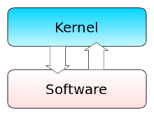
Monolithic

Slide 29
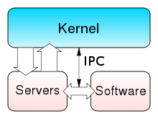
Microkernel

Slide 30
Distributions
Linux originally took a lot of technical ability to install
Different distributions included different software packages during installation
Red Hat
Debian – Ubuntu, etc.
Yggdrasil, etc., etc.
Package management

Slide 31
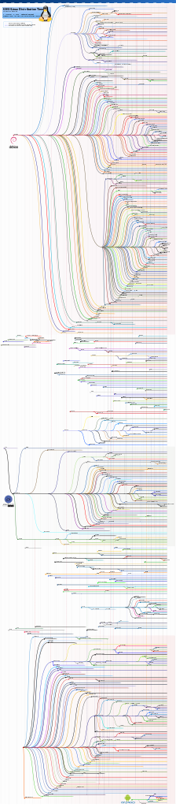

Slide 32
BSD Evolution
CMU created Mach
Microkernel
iOS and OS X
NextStep
GNU Hurd
OpenBSD, NetBSD, FreeBSD

Slide 33
Which is Best?
All of them
Converging
Depends on your needs
Ease of use, lots of graphical elements: OS X
Business apps: Windows
Server: Linux

Slide 34
Review
Questions: 2, 4, 6, 7, 9, 10
Exercise: 5

